Slide 1
Naukari Analysis
(P – 142)
Group 3:
- Mr. Rajkumar Balasaheb Chandoba
- Mr. PRAVIN PATAIT
- Christian Joshua Daniel Merwin Raja
- Mr. INDURI BHARGHAVA REDDY
- Miss Pritam Vilasrao Nimbalkar
- Mr.PARAG NANDKISHOR WANI

Slide 2
Business Objective:
As we know, analyzing the data will give us important insights in every sector/domain and help the business to make changes either in management level or to generate good market strategy.
So, analyzing the Naukri data will also provide better insights, and can be helpful in different ways. If we consider a student/ an aspirant perspective they need to know the pulse of the current job market.
Our Analysis may help them to prepare for their future either in terms of technology, Skills to be earned, salary and lot more
Scraping the web/Naukri data and analyzing them. Will also try to apply some machine learning models whenever it's necessary.
Think on whether it's possible to categories the different companies based on the details mentioned in the portal (Naukri)

Slide 3
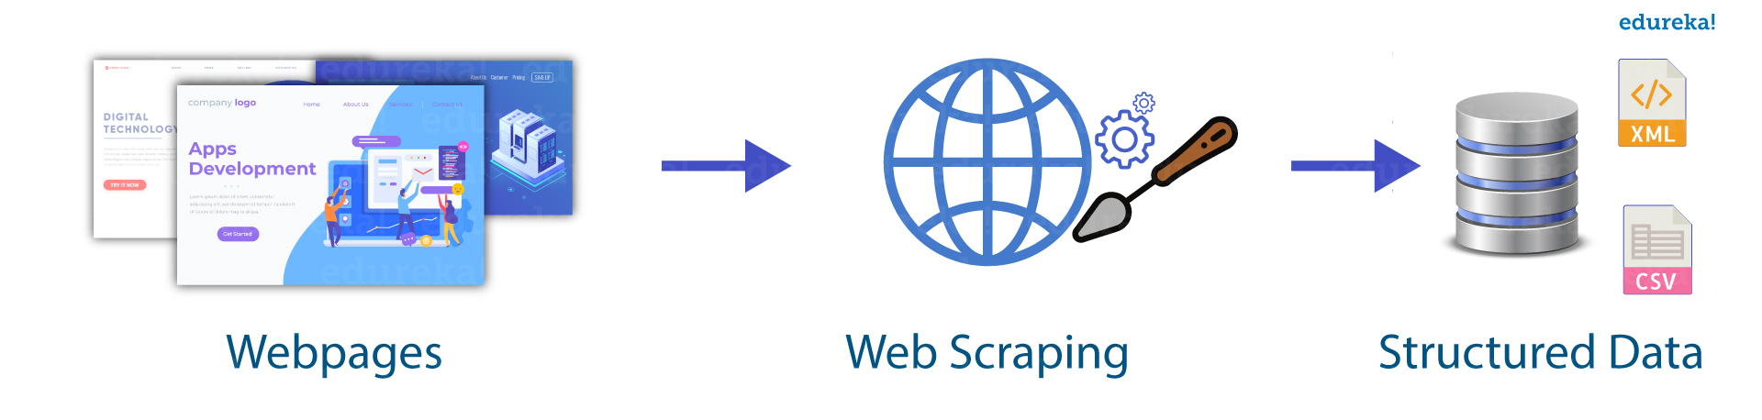
Information :
Web Scraping :
Web scraping is an automatic method to obtain large amounts of data from websites. Most of this data is unstructured data in an HTML format which is then converted into structured data in a spreadsheet or a database so that it can be used in various applications.
Is Web Scraping Legal?
Talking about whether web scraping is legal or not, some websites allow web scraping and some don’t. To know whether a website allows web scraping or not, you can look at the website’s “robots.txt” file.

Slide 4
Libraries used for Web Scraping:
Selenium : Selenium is a web testing library. It is used to automate browser activities.
BeautifulSoup : Beautiful Soup is a Python package for parsing HTML and XML documents. It creates parse trees that is helpful to extract the data easily.
Pandas : Pandas is a library used for data manipulation and analysis. It is used to extract the data and store it in the desired format.
Scrapy : Scrapy is a very popular open-source web crawling framework that is written in Python. It is ideal for web scraping as well as extracting data using APIs
Here we have used Selenium.
Selenium is a python library that can scrape dynamic web easily. It is used also used for web automation & testing. Scraping data from the web is a small part of its library.

Slide 5
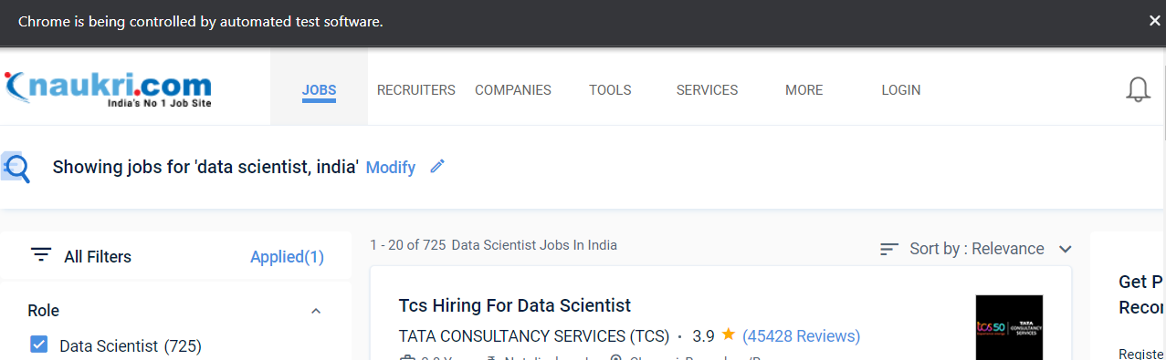
Steps for Web Scraping :
Install and Import : pip install selenium
Install and Access WebDriver :
driver = webdriver.Chrome('/Users/MyUsername/Downloads/chromedriver’)
Access Website Via Python:
driver.get("https://www.naukri.com/data-scientist-jobs-in-india?k=data%20scientist&l=india")

Slide 6
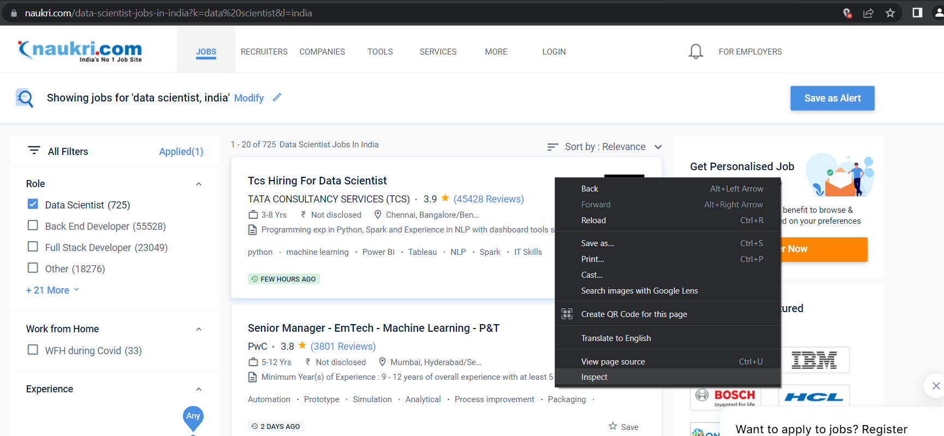
Inspecting the Page :

Slide 7
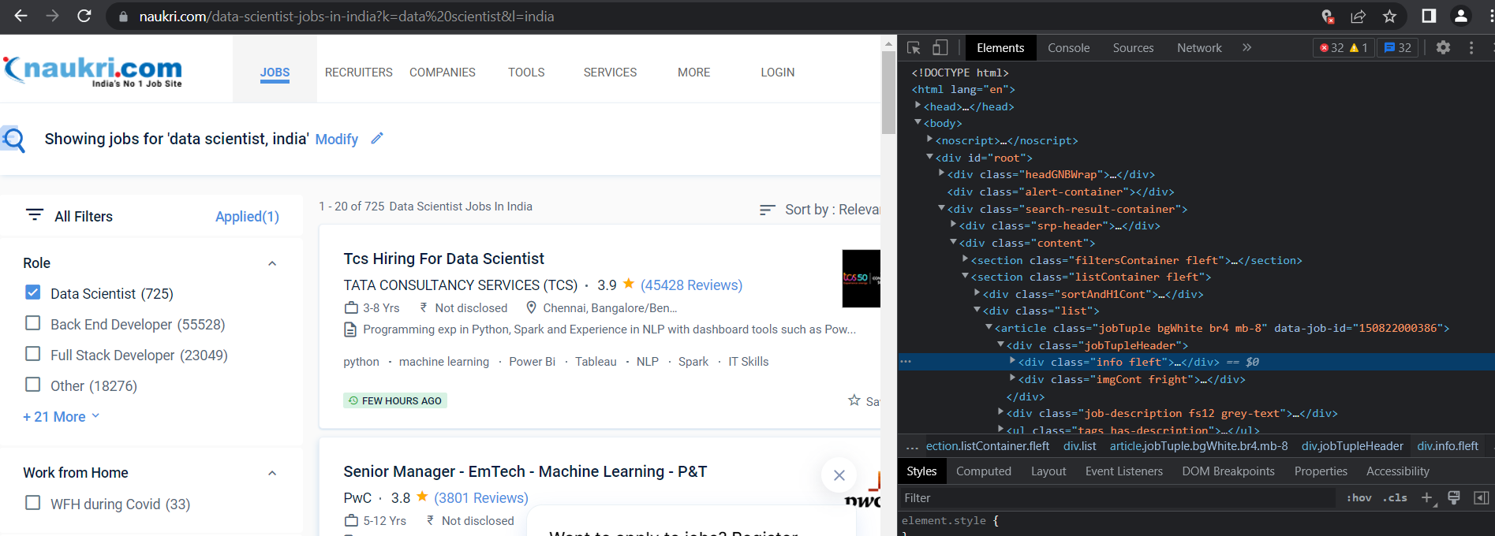
When you click on the “Inspect” tab, you will see a “Browser Inspector Box” open
5. Locate Specific Information You’re Scraping :
In order to extract the information that you’re looking to scrape, you need to locate the element’s XPath. An XPath is a syntax used for finding any element on a webpage
jobtitle_xpath = '(//*[@class="jobTuple bgWhite br4 mb-8"])['+index+']/div/div/a'

Slide 8
6. Web Interaction & Navigation :
7. Waits :
Every Modern Day Website uses ajax to load the contents of the web. Thus, different parts of the website load at different times making it difficult to scrape data from them. Waits can resolve this issue by providing a slack of interval between two continuous actions.
Explicit Wait:
It is a piece of code that waits for a certain condition to happen before processing code execution.

Slide 9

Exploratory Data Analysis

Slide 10
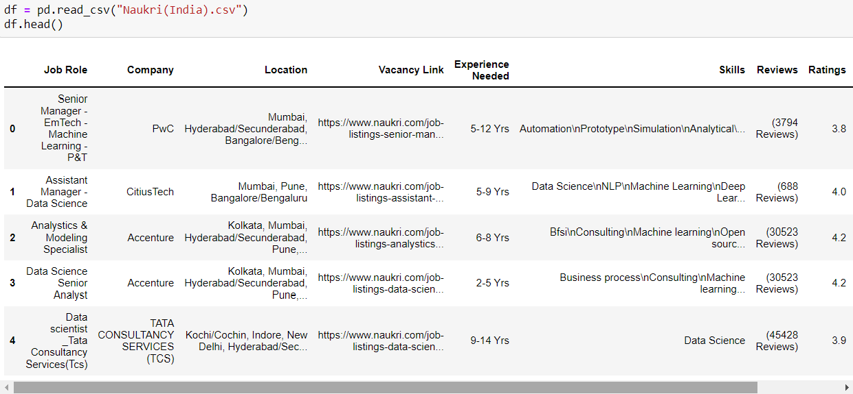
Dataset :
If you observe Skill column, you can observe that each row contain ‘\n’ instead of ‘comma’.
Reviews column contain parenthesis and word “Reviews”.
Experience needed column, each row contain “Yrs” .

Slide 11
Feature Set :
Job Role : Post of the candidate for which he/she has to work
Company : Name of Companies
Location : Location of the Company who provide job.
Vacancy Link : URL of vacancy
Experience Needed : Minimum Job Experience
Reviews : A review is an evaluation of a company
Ratings :
Skills :
Job Posted :
Salary :

Slide 12
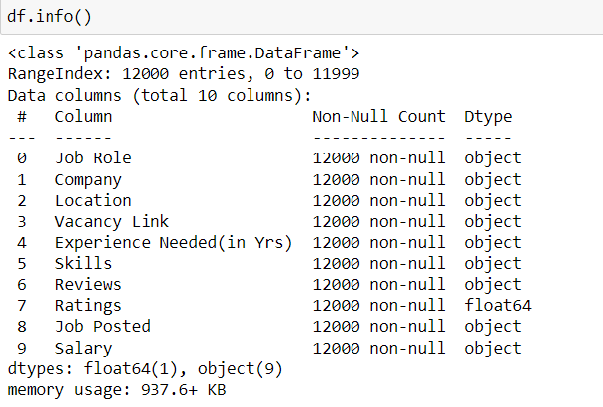
Dataset Details :
Shape of Dataset | (12000 , 10)
Categorical Features | 0
NULL Values | 0
Duplicate Values | 0

Slide 13
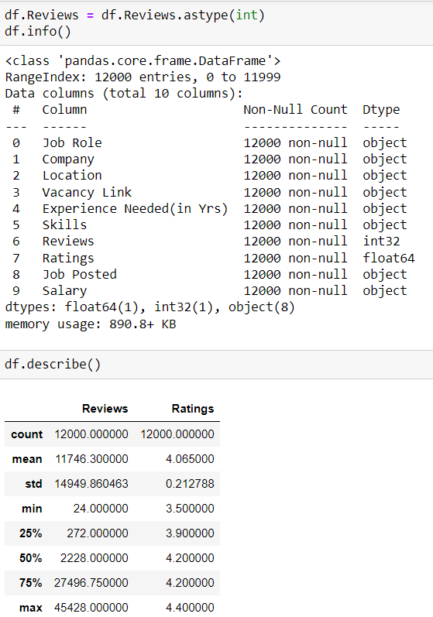
Here we change the datatype of Reviews column from ‘object’ to ‘int’.

Slide 14
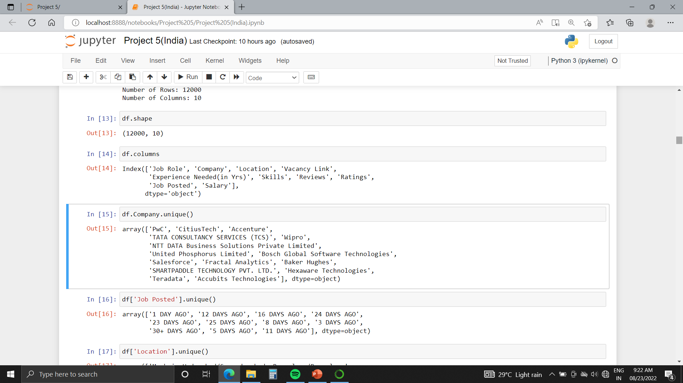
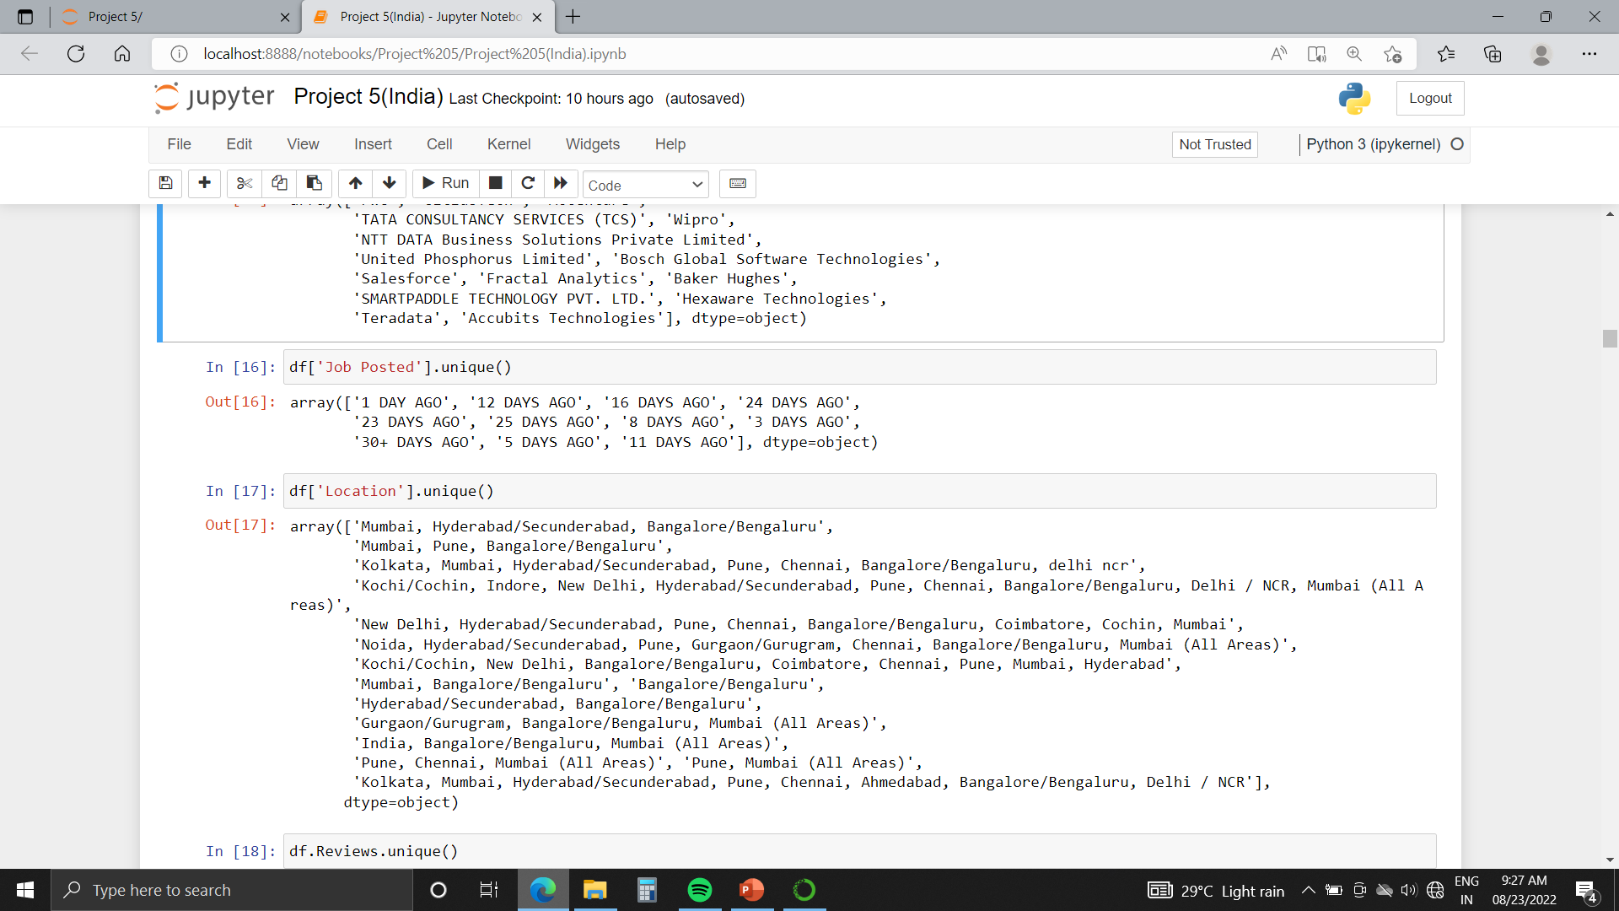
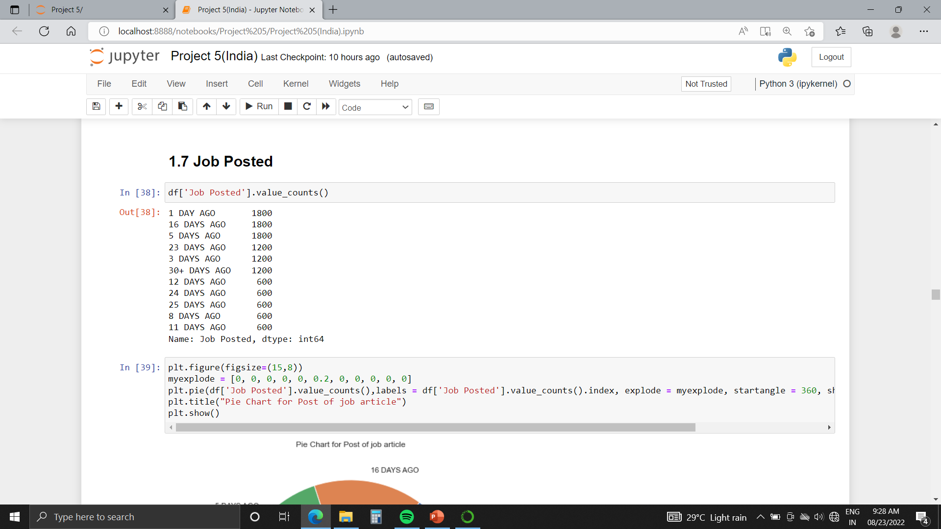
Feature “Company”:
Number of unique Companies : 15
Name of 15 Companies :
Feature “Job Posted”:

Slide 15
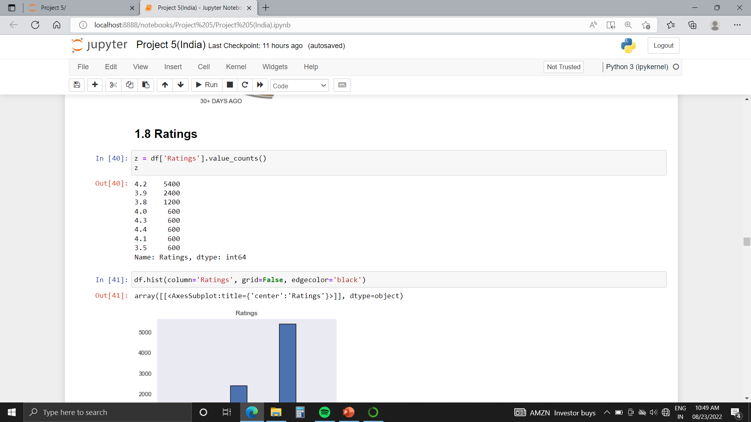
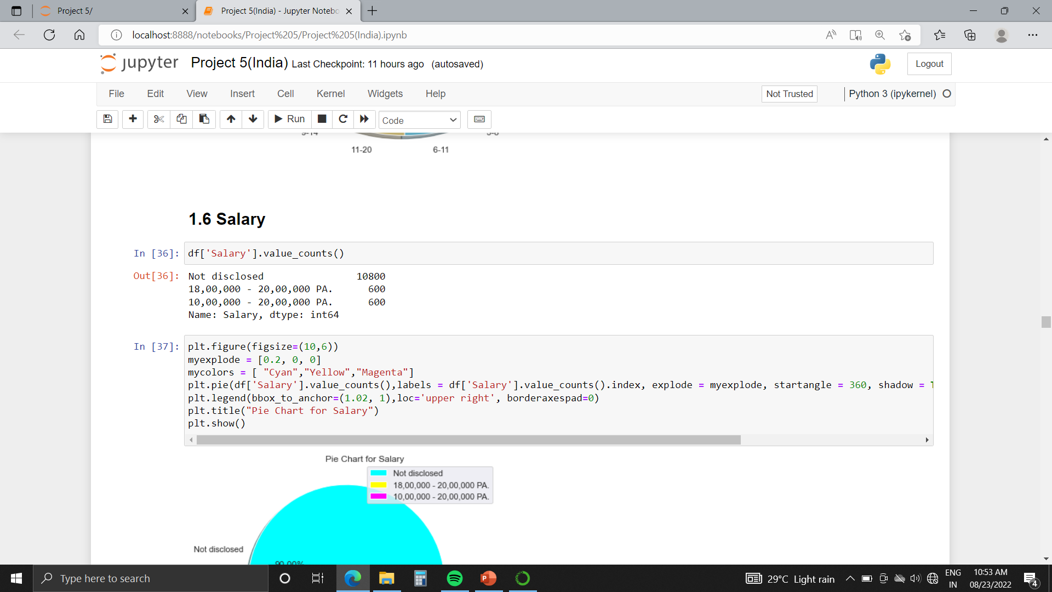
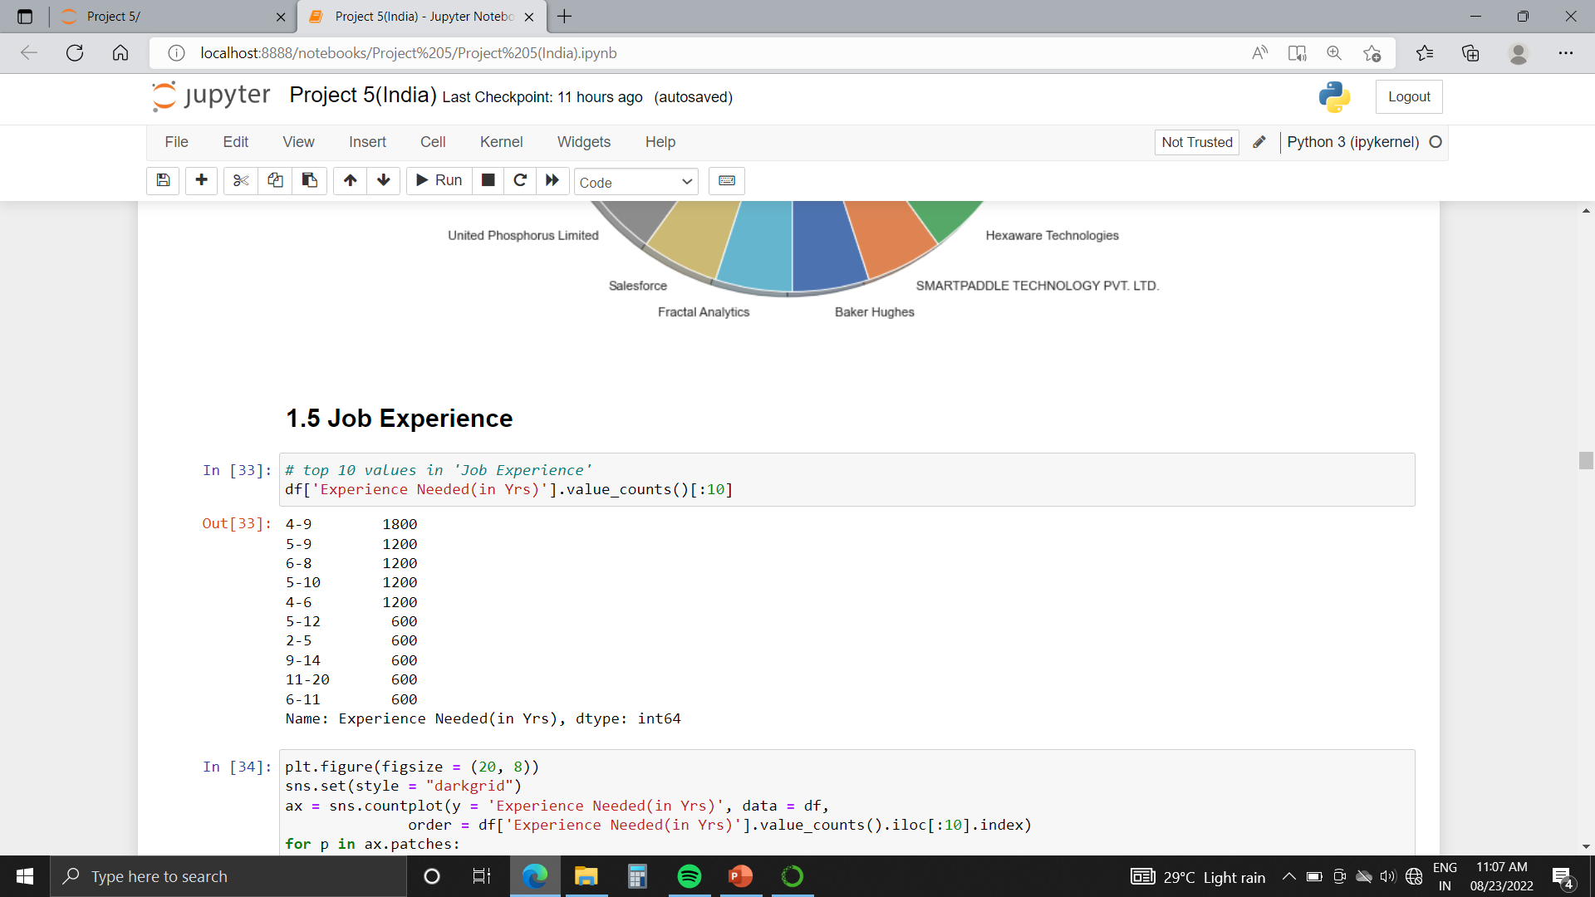
Feature “Ratings”:
Feature “Salary”:
Feature “Experience Needed(in Yrs)”:

Slide 16
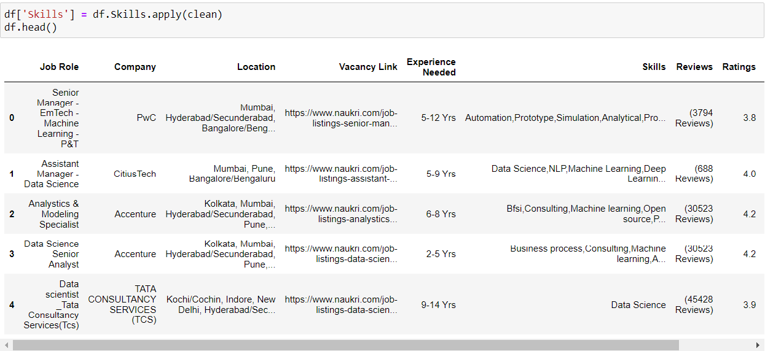
If you see the previous dataset image, in that Skills column contain \n instead of comma in each row.
We remove \n and replace it with comma.

Slide 17
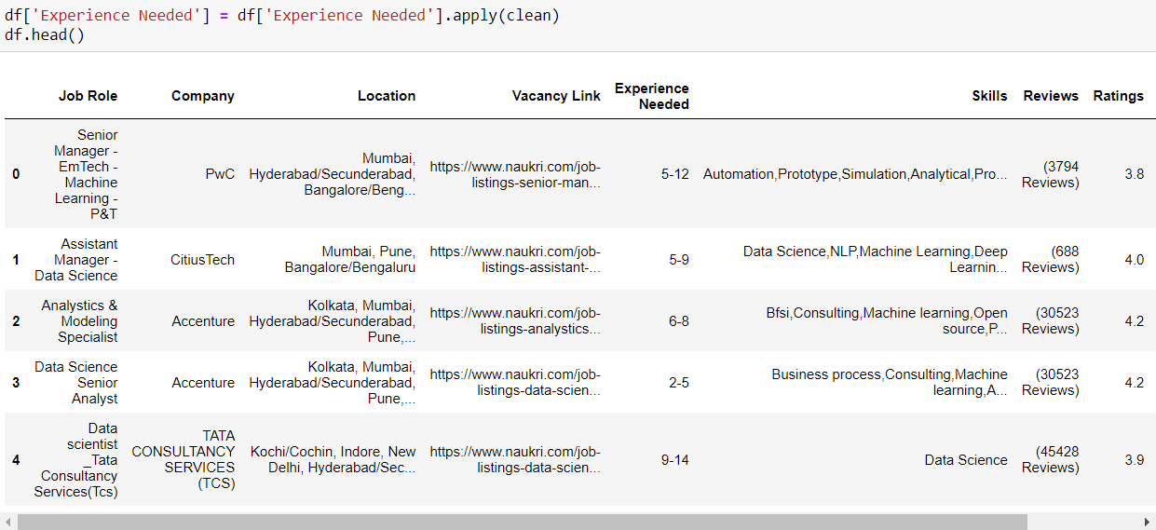
In Original Dataset, Experience Needed column contain “Yrs” .
After removing word “Yrs” ,dataset looks like this..

Slide 18
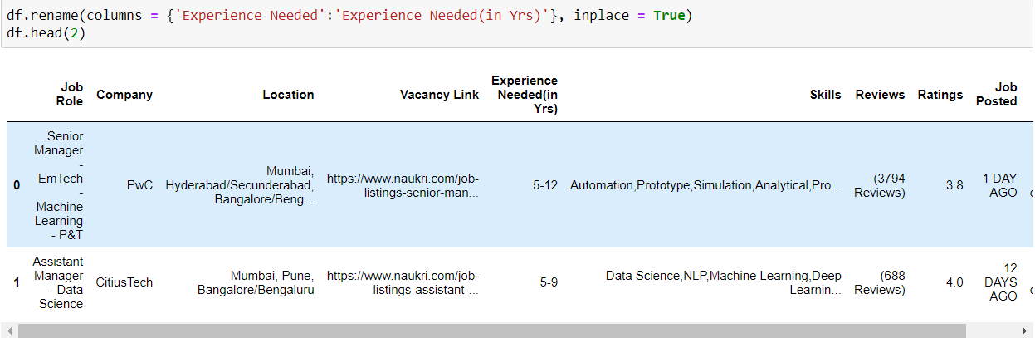
3. Here we change the name of column from Experience Needed to Experience Needed(in Yrs)

Slide 19
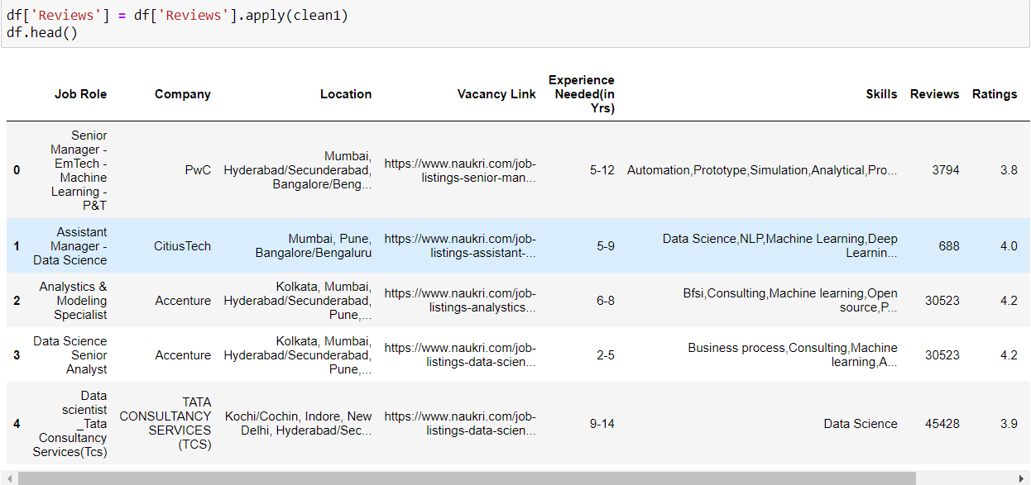
4. Here we clean Review Column by removing unnecessary parenthesis and word “Reviews” which is present in the whole column.

Slide 20
Univariate Analysis

Slide 21
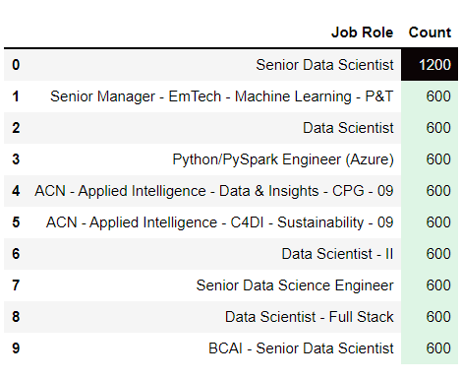
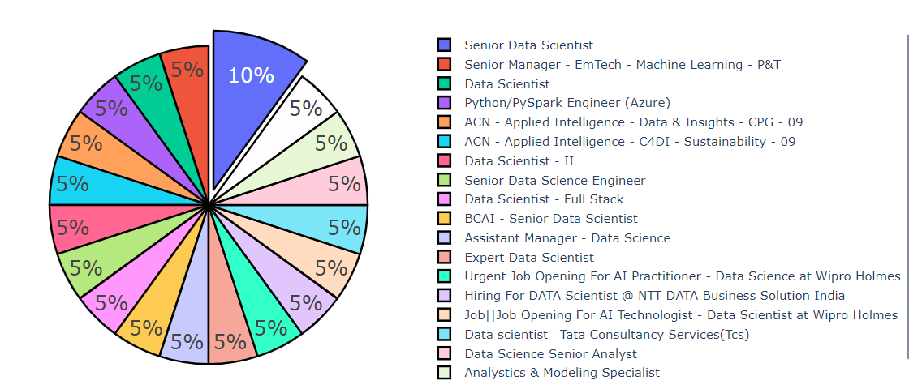
1. Job Role :
From the table, we can say that there is a high requirement of Senior Data Scientist.

Slide 22
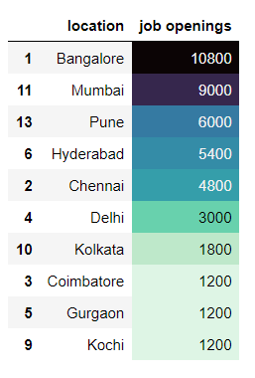
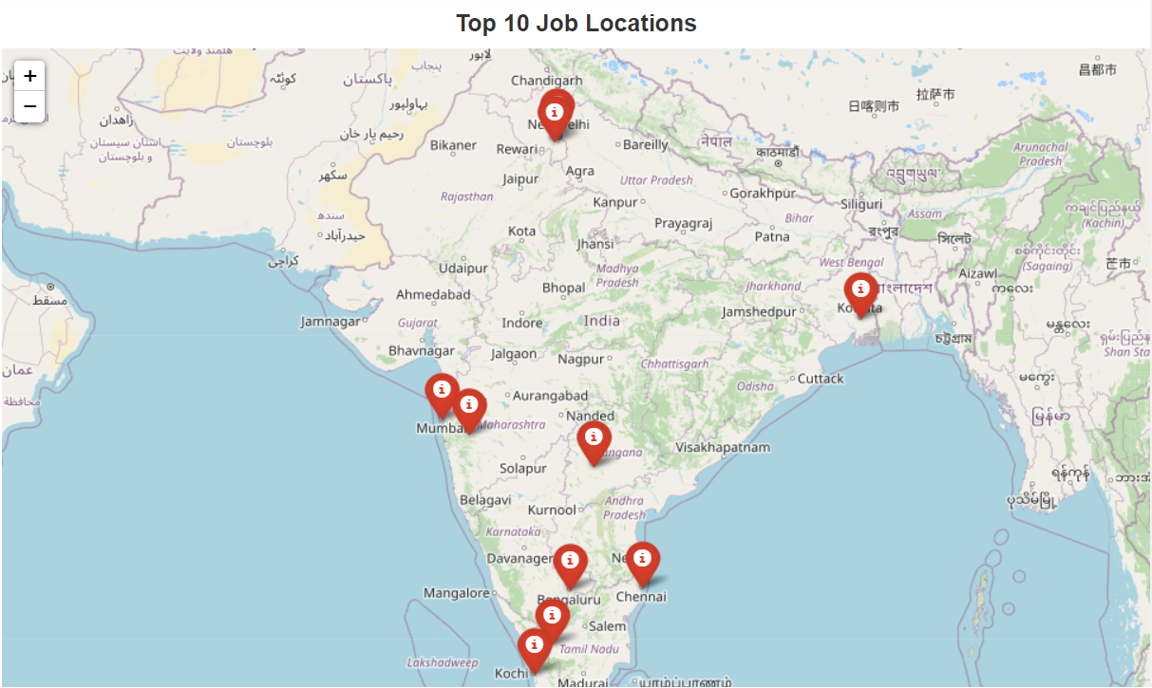
2. Top 10 Job Location based on Job Openings :

Slide 23
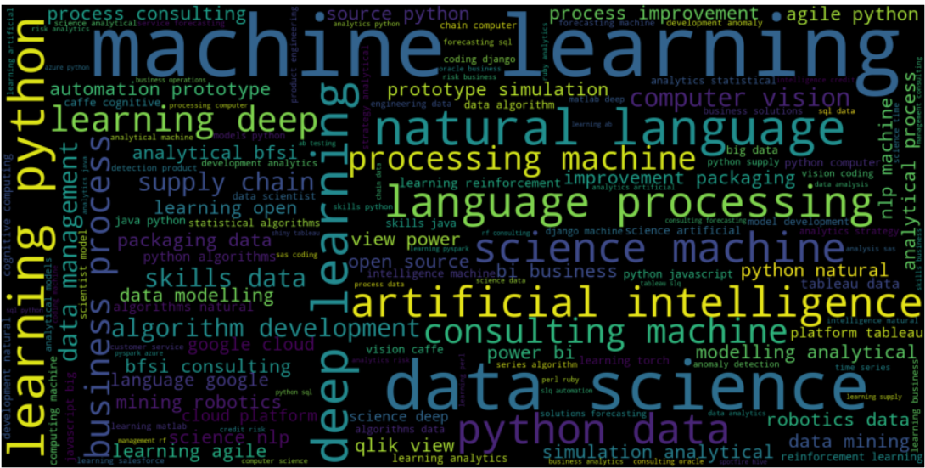
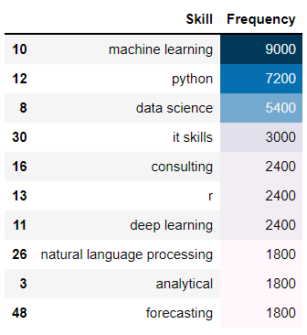
3. Top 10 Required Skills :

Slide 24
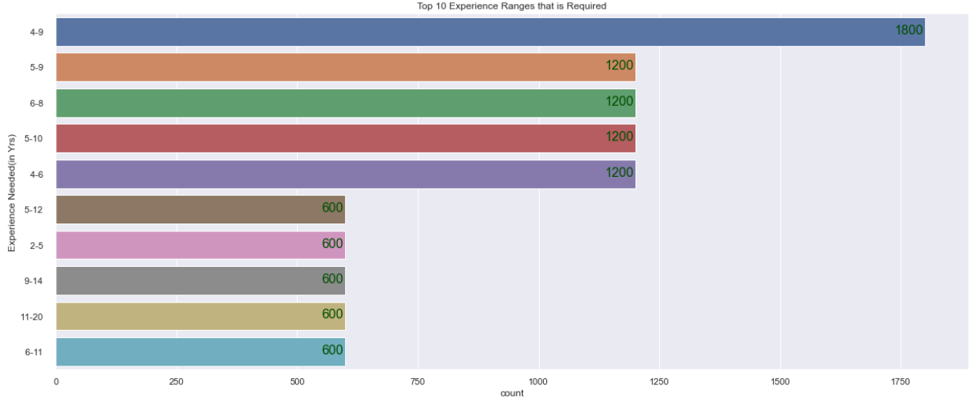
4. Top 10 Experience Ranges that is required :
Highest required Experience Range is 4-9 Yrs

Slide 25
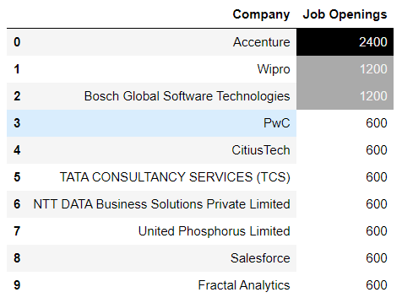
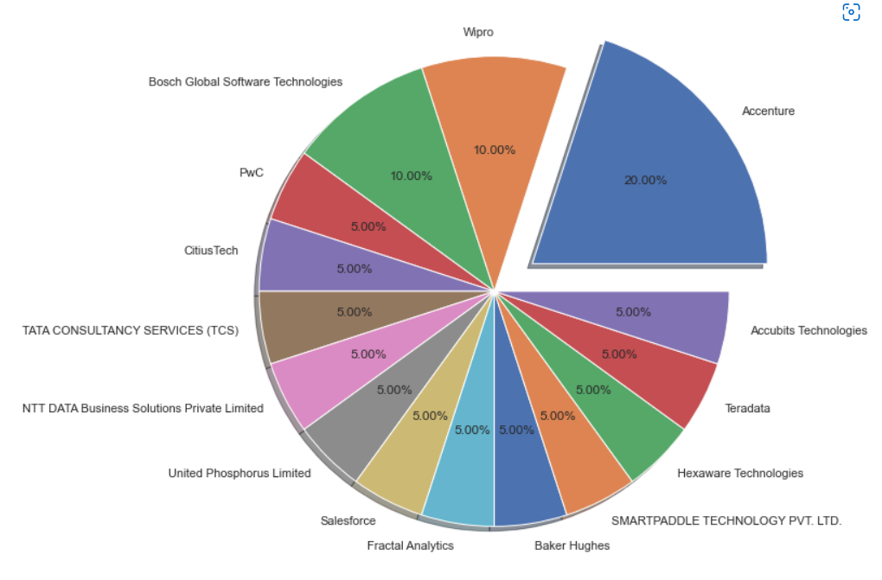
5. Top 10 Companies based on Job Openings :

Slide 26
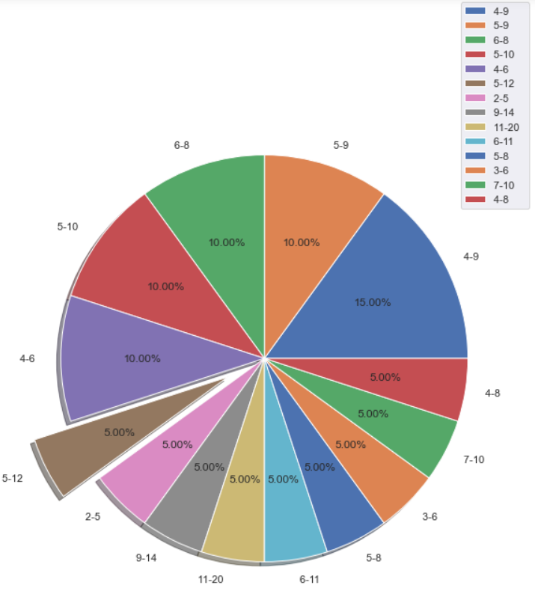
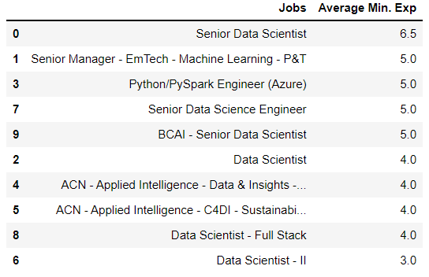
6. Top 10 Jobs based on Average Minimum Experience
7. Pie Chart for Experience Needed(in Yrs)

Slide 27
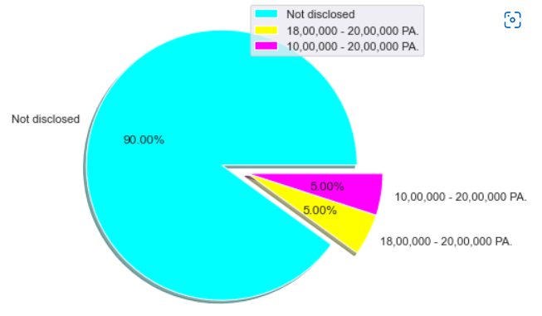
8. Salary :
90% Companies are “ Not Disclosed” Salary
5% Companies give salary 10,00,000 – 20,00,000 PA
5% Companies give salary 18,00,000 – 20,00,000 PA

Slide 28
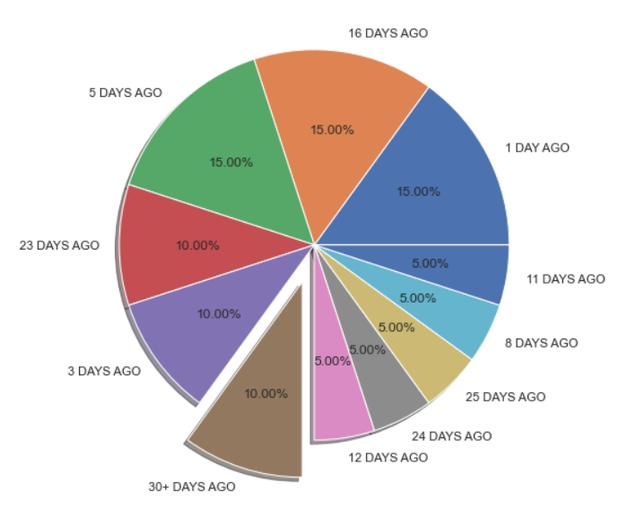
9. Job Posted :
From Pie Chart, 10% of Job Articles are posted 30+ Days Ago

Slide 29
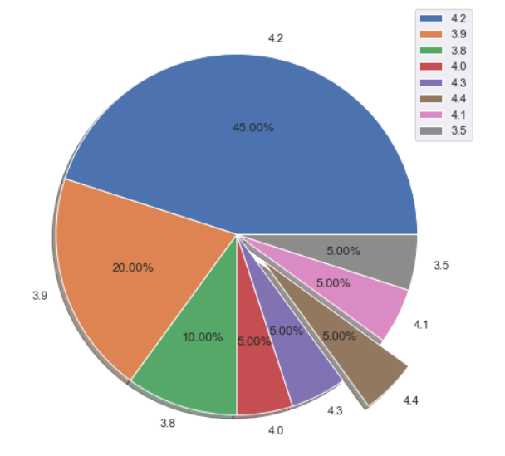
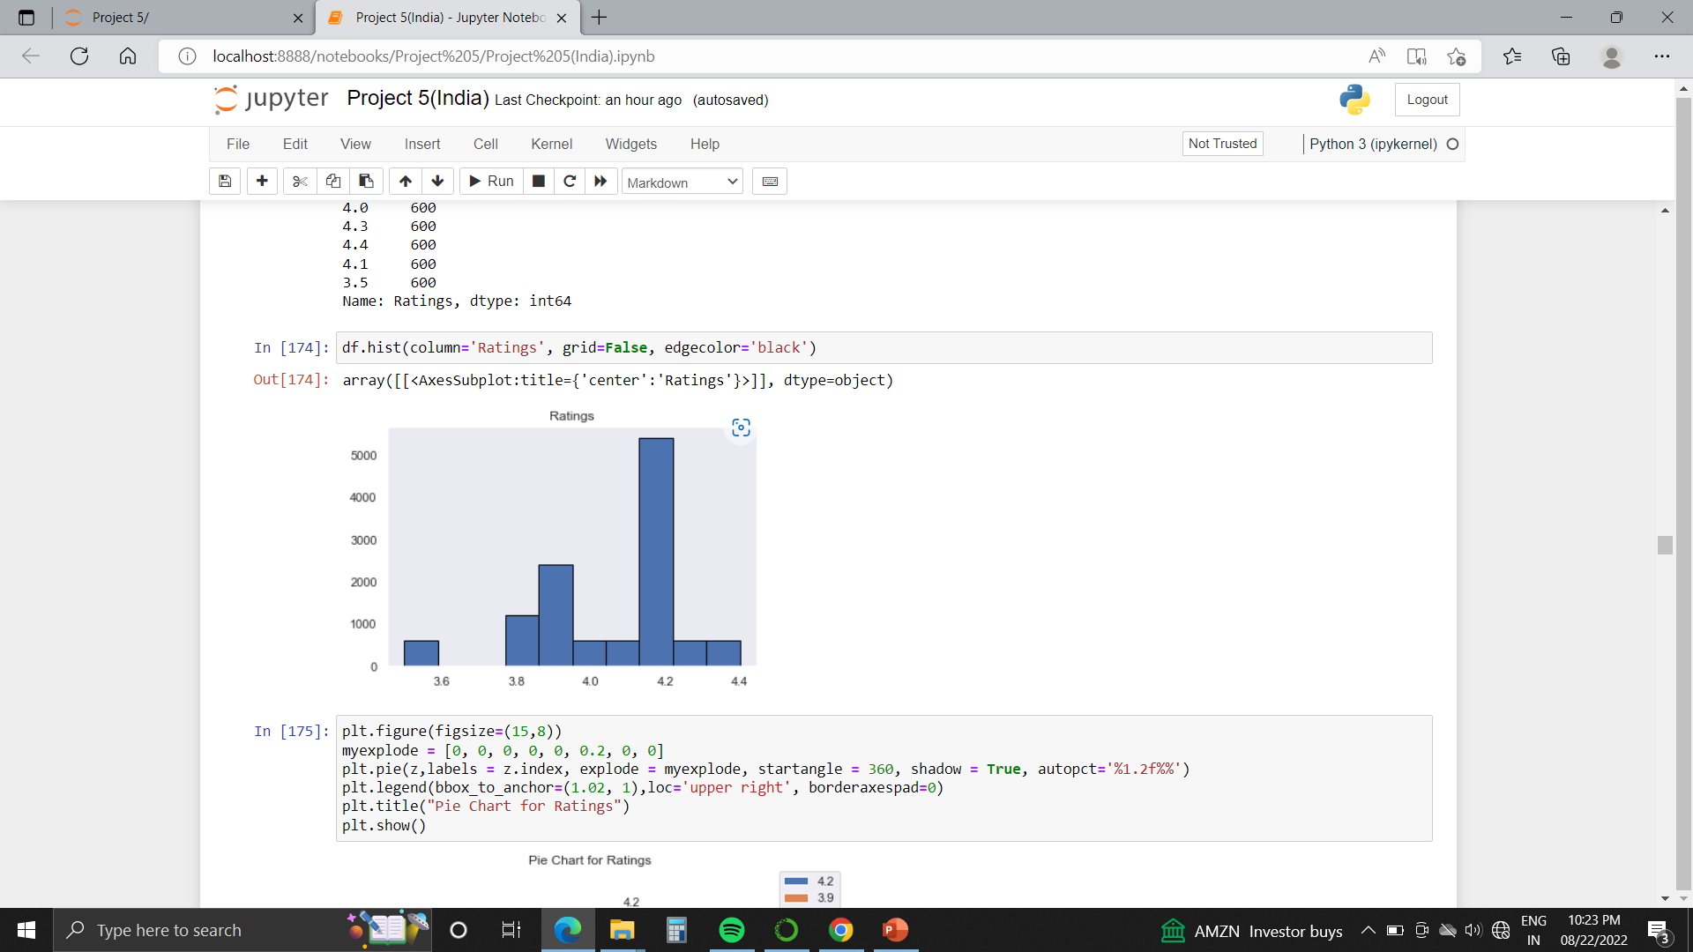
10. Ratings : 45% of the Companies have rating of 4.2

Slide 30
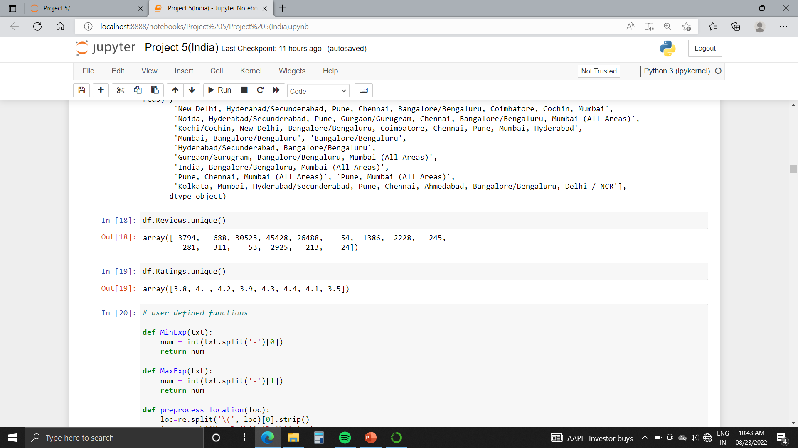
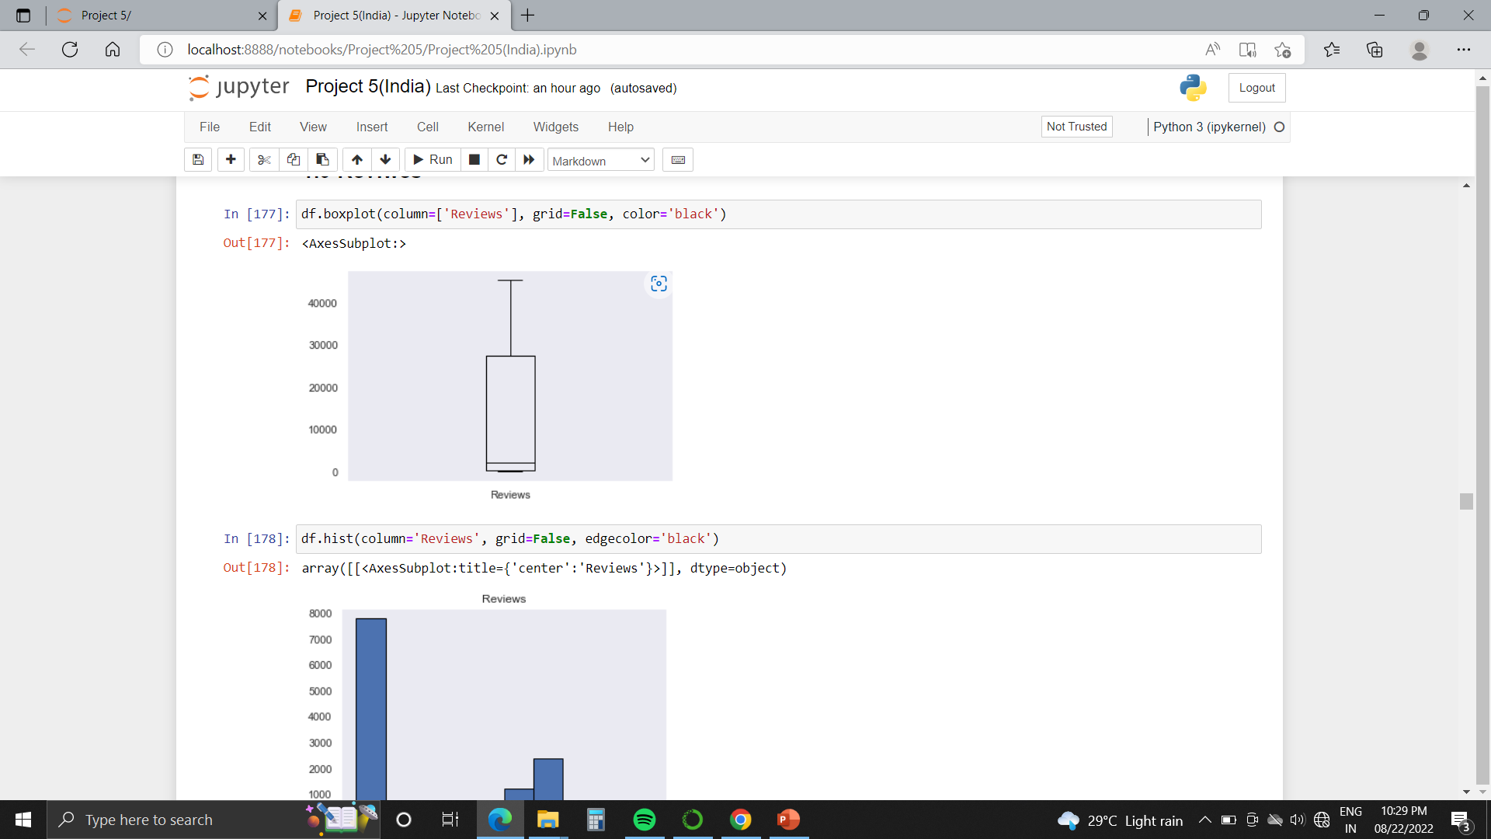
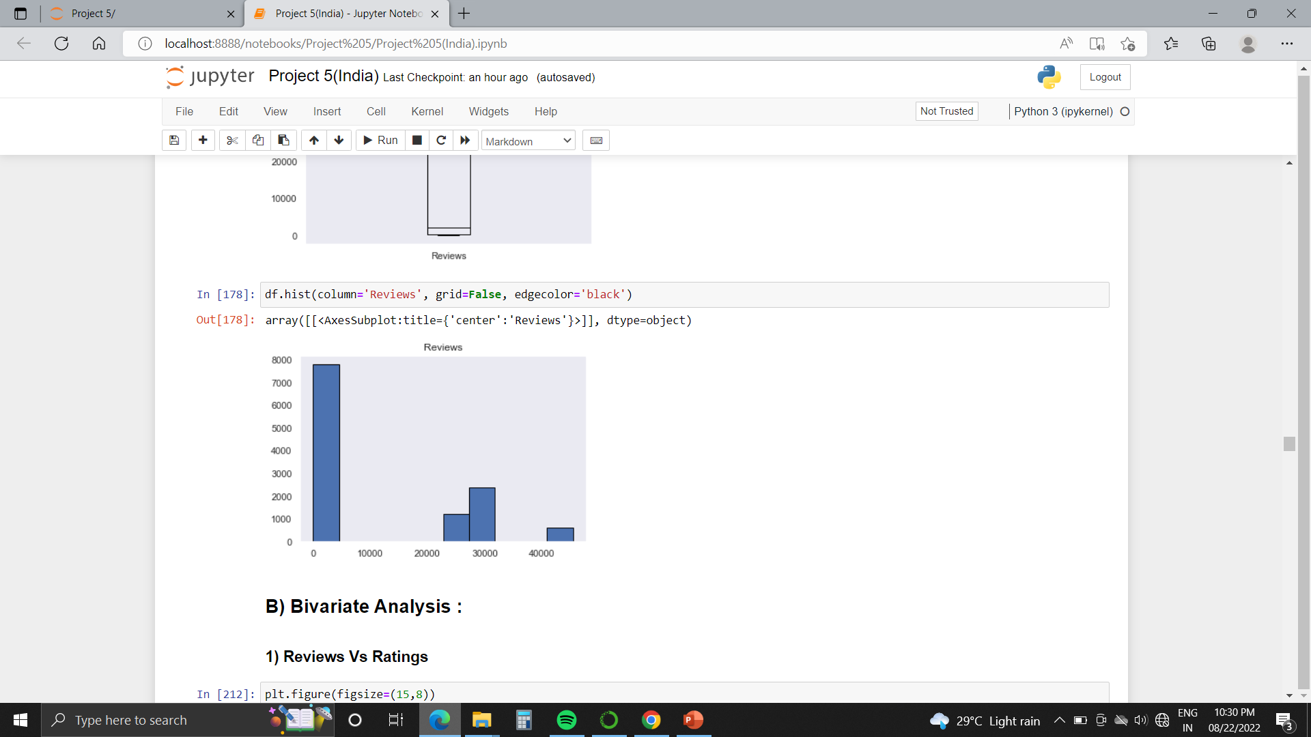
11. Reviews :
Boxplot
Histogram
Lower median value
The line in the middle of the box plot is close to Q1. That means it is positively skewed(Right Skewed).
No outliers.

Slide 31
Bivariate Analysis

Slide 32
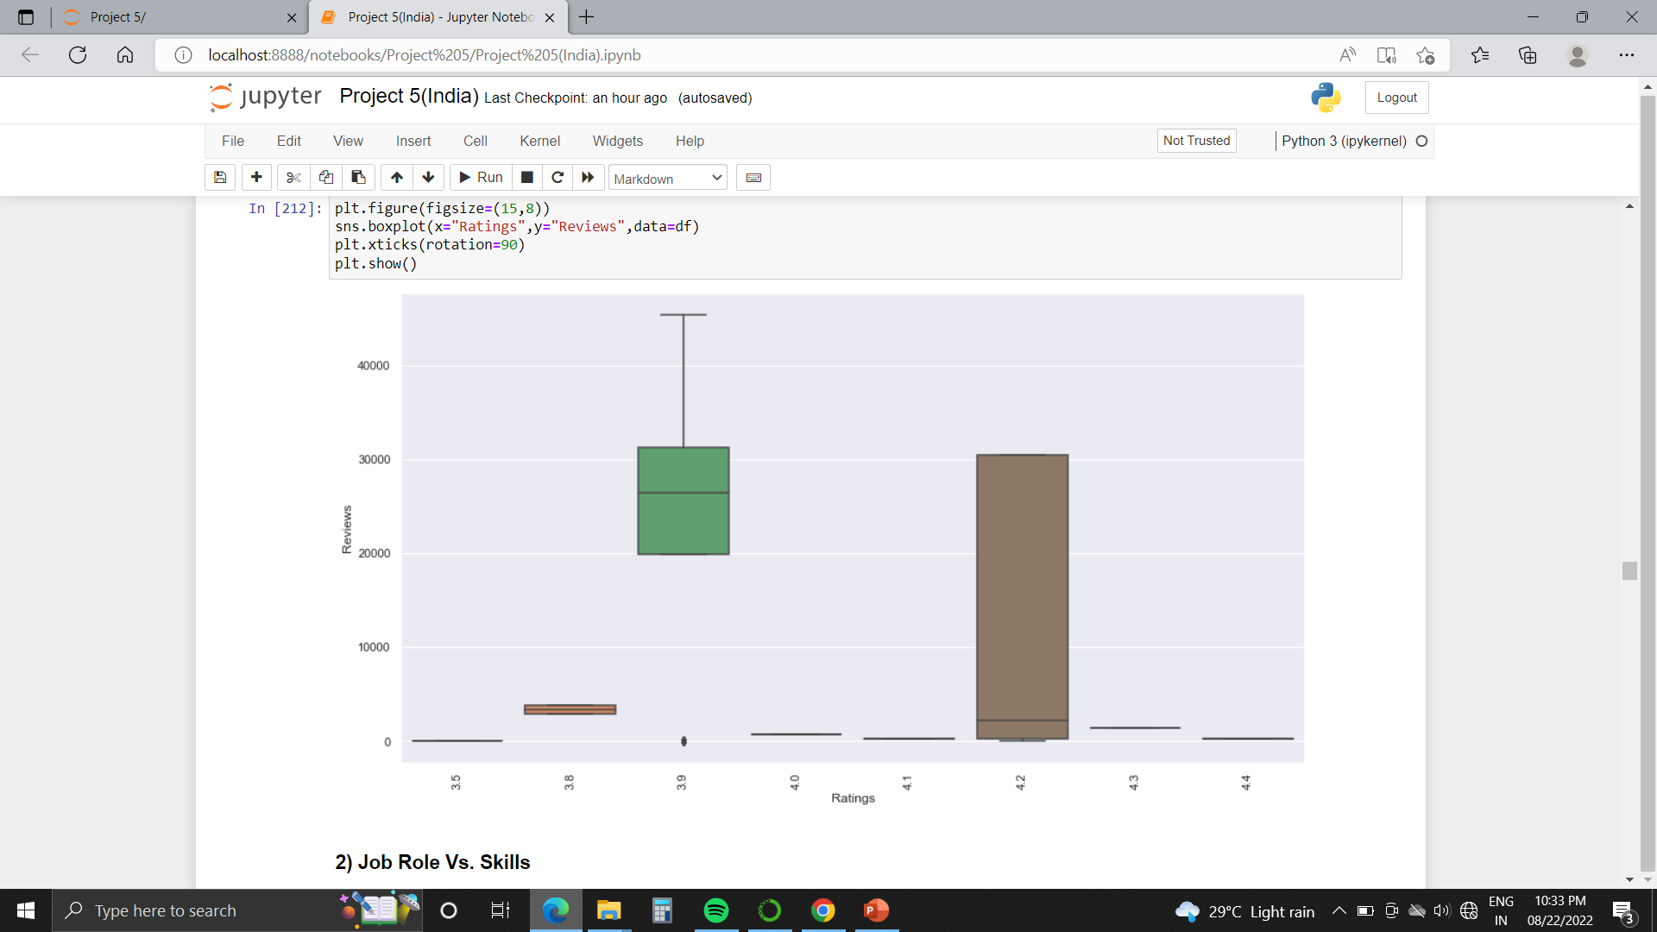
1. Reviews Vs Ratings:

Slide 33
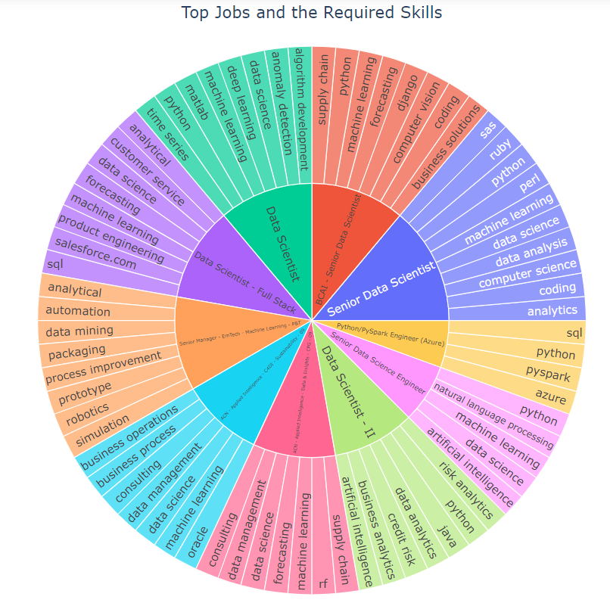
2. Top Jobs Role and Required Skills

Slide 34
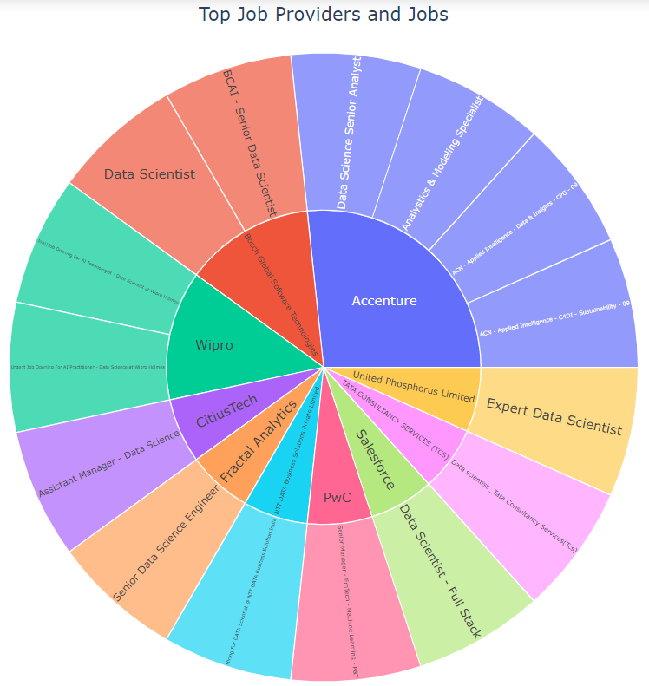
3. Top Company Vs Job Role

Slide 35
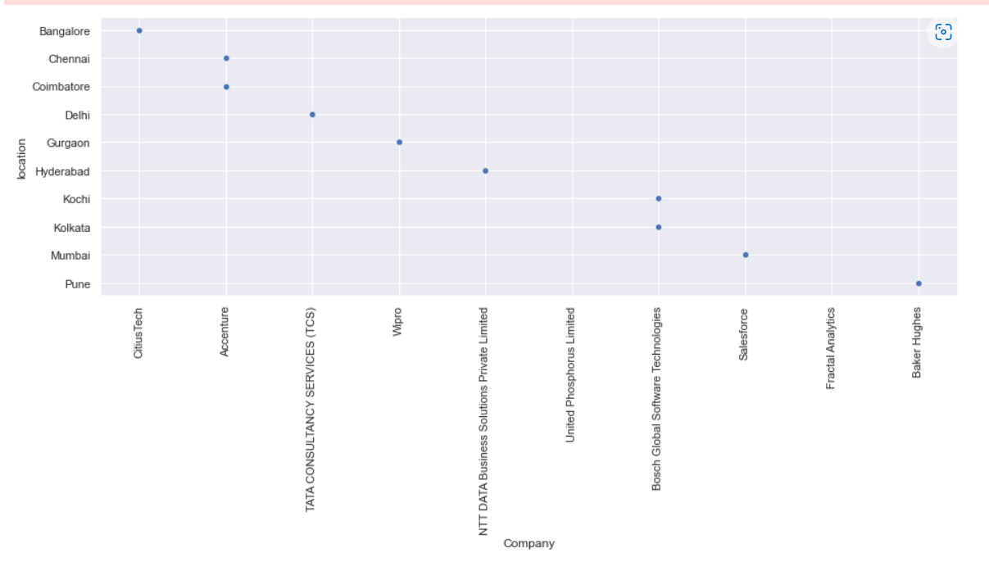
4. Company Vs Location :
From below graph we can say that ,Company “Accenture” Located at Chennai and Coimbatore has high job Requirements.

Slide 36
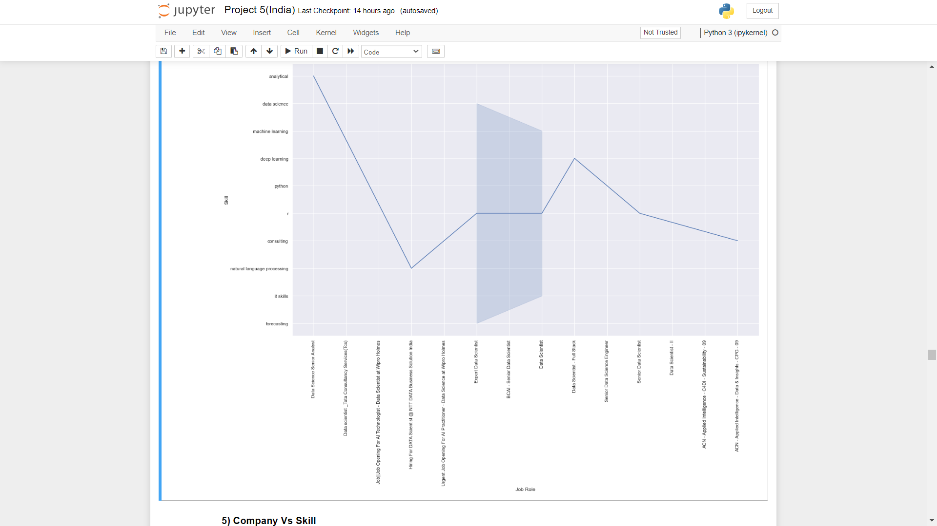
5. Job Role Vs Skills :
You can read the graph as,
For Data Science Senior Analyst (Job Role) required skill is Analytics.

Slide 37
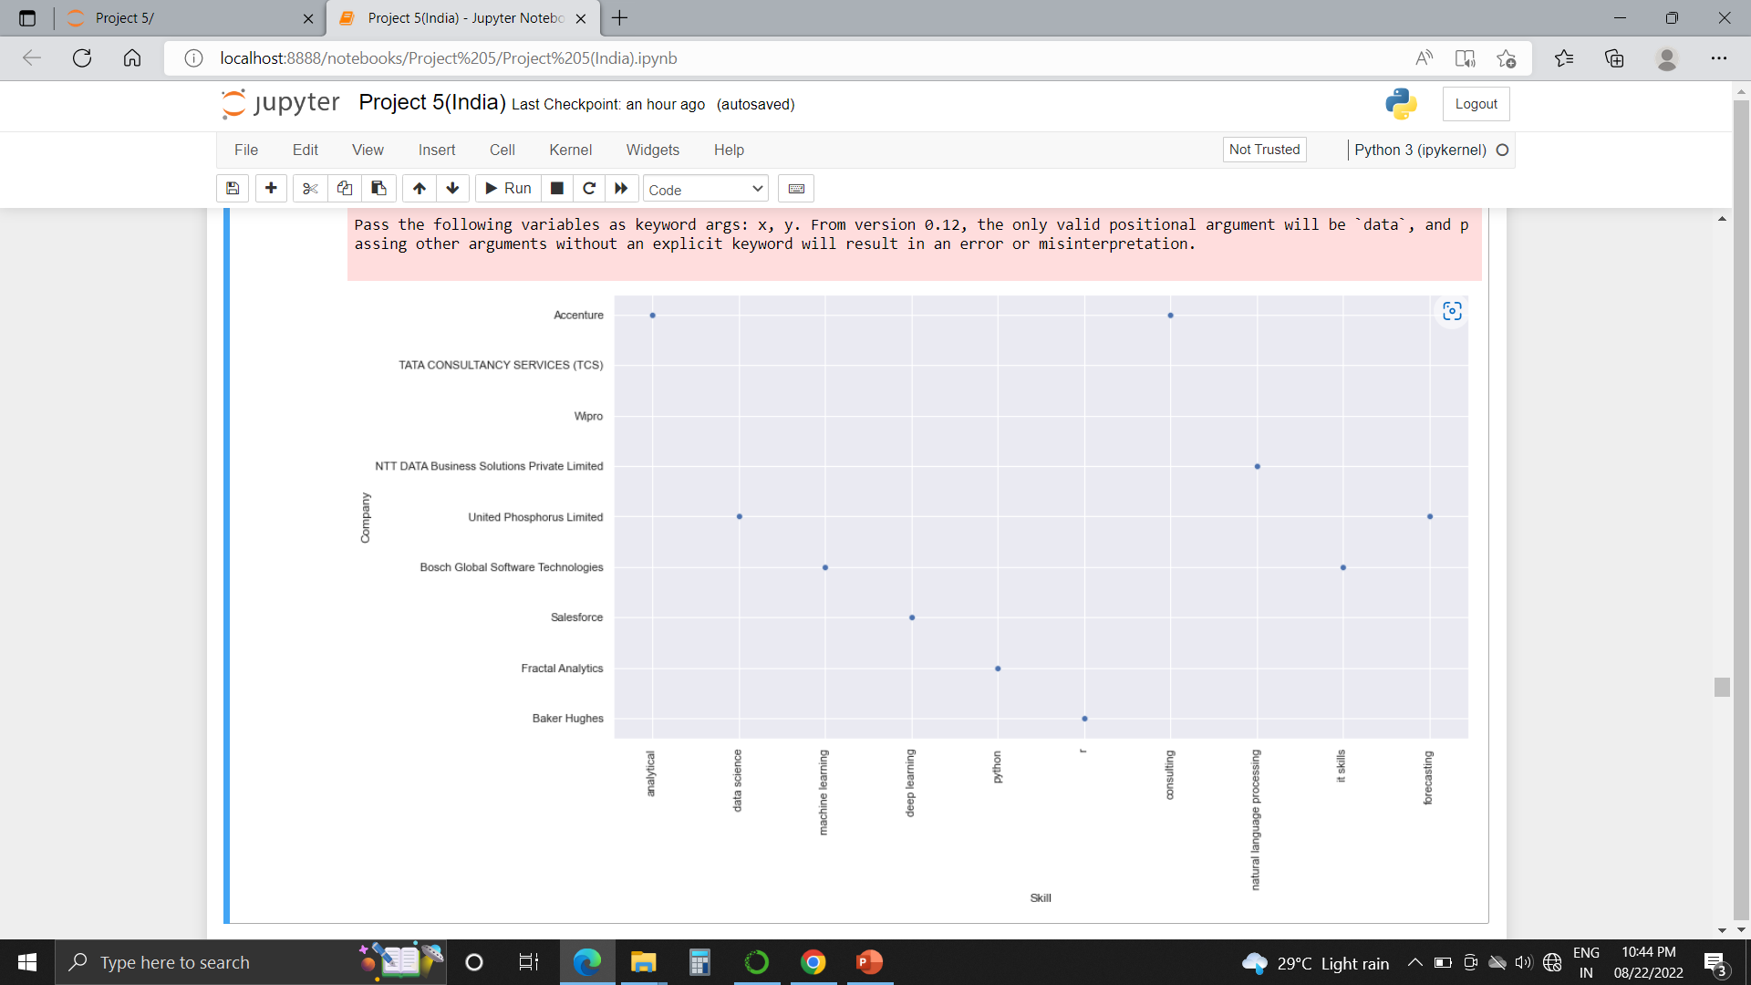
6. Company Vs Skills :
For Company “Accenture” most required skill is “Analytics”

Slide 38
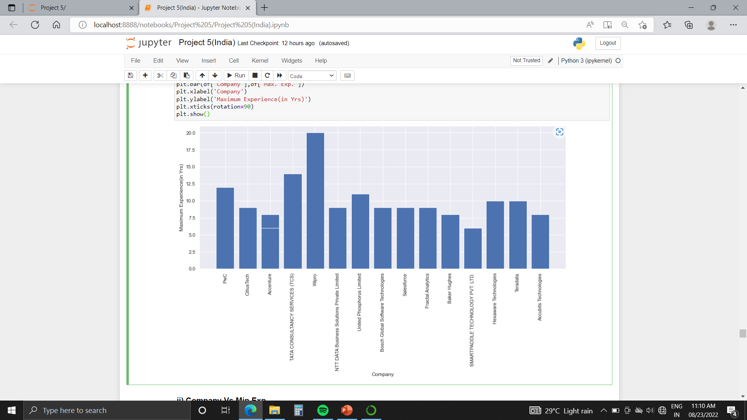
7. Company Vs Max. Experience :
“Wipro” Requires Maximum Experience of 20 Years.

Slide 39
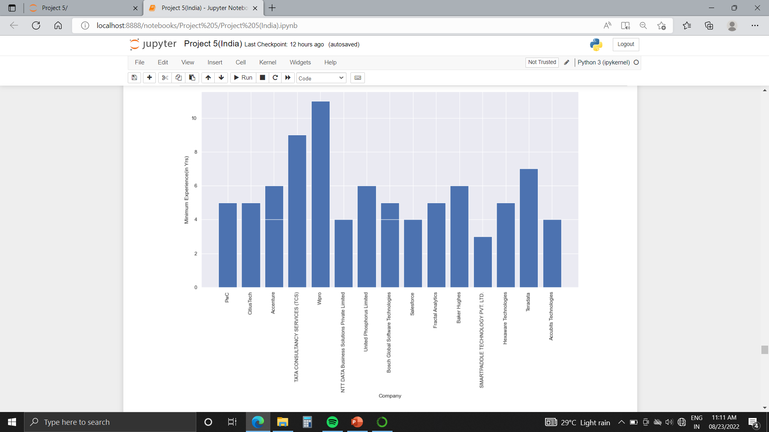
8. Company Vs Min. Experience :
“Wipro” Requires Maximum Experience of 11 Years.

Slide 40
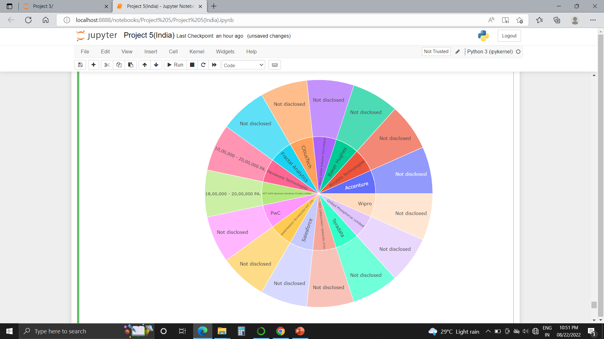
9. Company Vs Salary:

Slide 41
Multivariate Analysis

Slide 42
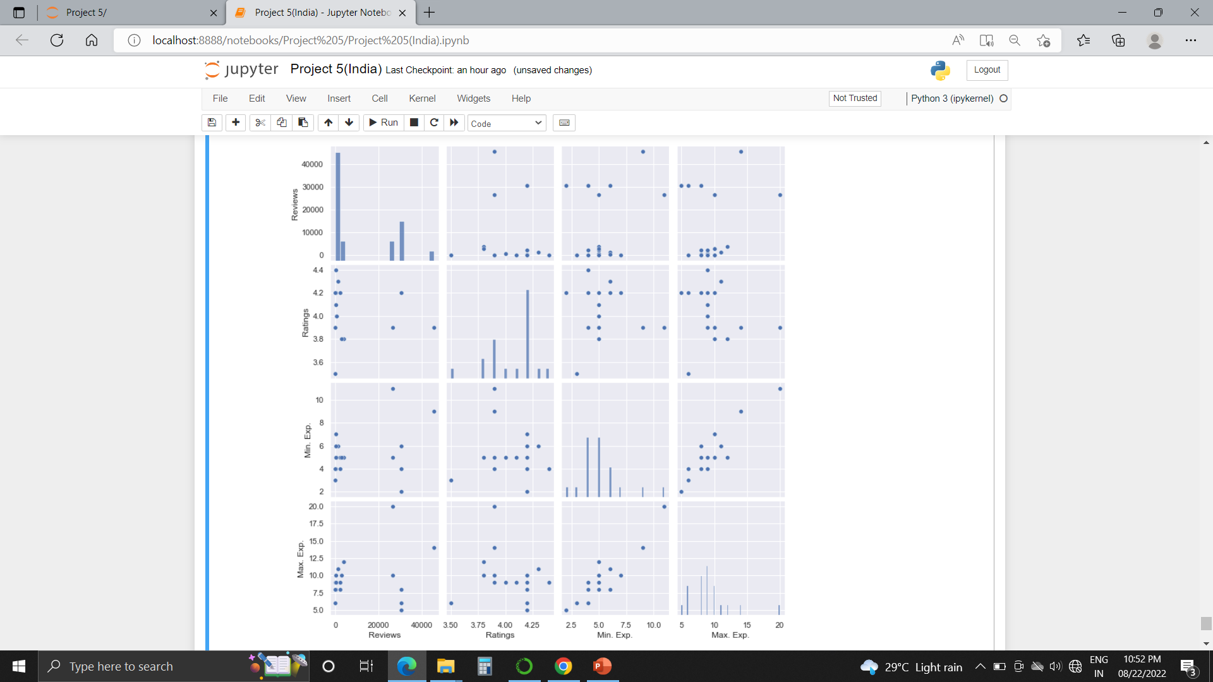
1. Pairplot:

Slide 43
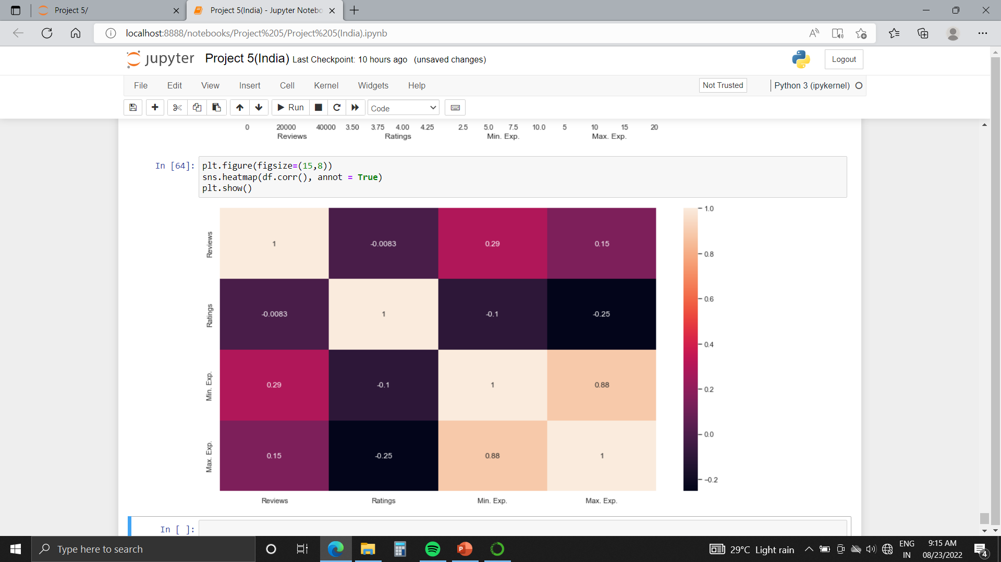
2. Heatmap:
From Heatmap we observe that, Max. Exp. And Min. Exp. Shows High Correlation.

